Slide 1
Poverty Free India

Slide 2
The Truth
After the 18th century, the relation between “poverty and India” is not breakdown after many efforts, plan and scheme . Firstly we should define 2 things (A) what is poverty? (B) who is poor? when we go to celebrate our 71th independence day we don’t know how many poor live in India . many committee give many reports and every reports shows different data and statics. so firstly define exact number because Good Data helps to make Good plan.

Slide 3
What if we can eliminate poverty from India?
The current population of India is 1,355,388,325 as of Sunday, August 5, 2018, based on the latest United Nations estimates.
Among the estimated population 17% of the population lives below the poverty line.
The change to eliminate poverty from india and making india poverty free can only be achieved only and only if we stick together and work as a part of a team – UNITED WE STAND DIVIDED WE FALL.

Slide 4
The Plan
The current Population of india is 1,355,501,856
Among this 17% of the population stands to be below poverty line.
The remaining left is 83%.
Our team is trying to built a portal by which the remaining population that is 83% of 1,355,501,856 can donate.
If the remaining population can donate even single 1.00 Rs from there side we can remove poverty from our country and can make India Poverty Free.
The Revenue that will be collected can save some once life, give then food to eat, education and knowledge to children's and much more that no one can imagine.

Slide 5
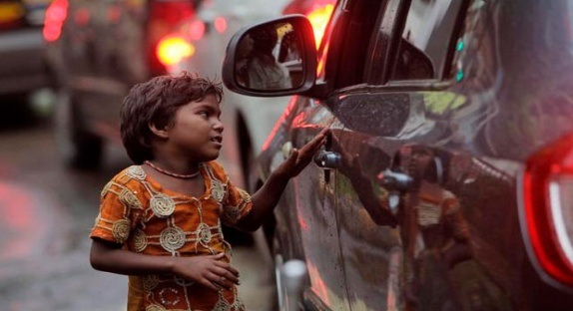
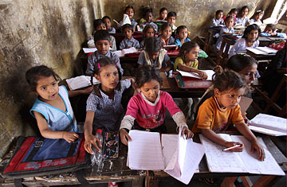
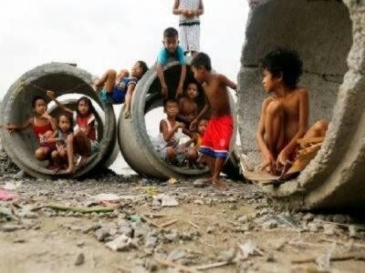
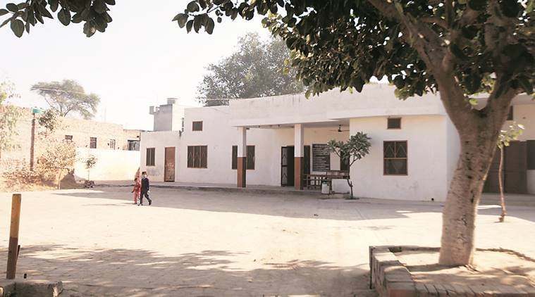

Innovation for Society
Lets work together and be a part of better future .
From
To
#BE THE CHANGE

